Slide 1
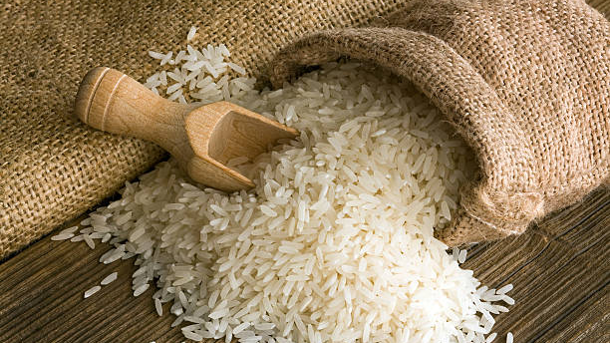
Rice Classification
GitHub link: https://github.com/PujaAmmineni/Rice-Variety-Classification-and-Quality-Evaluation-Using-Image-Analysis/tree/master
Deva Priya Mankena|Krishna Mokkapati|Poojith Mendem|Puja Ammineni|Suhani Yalaga

Slide 2
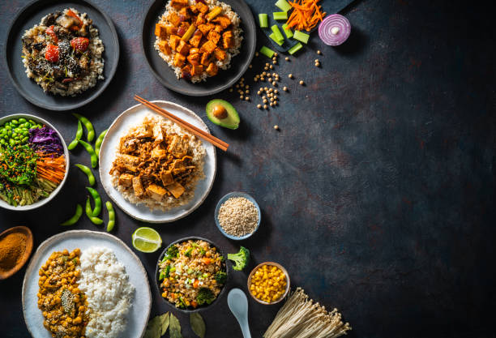
Goal
Quality Assurance & Fraud Prevention
Agricultural Optimization
Supply Chain Efficiency

Slide 3
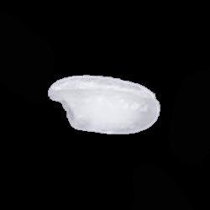
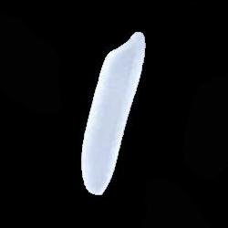
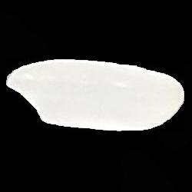
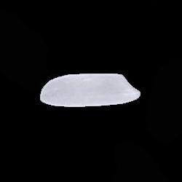
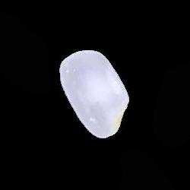
Dataset
This dataset is taken from the Kaggle :
https://www.kaggle.com/datasets/muratkokludataset/rice-image-dataset/data
Rice Varieties: Arborio, Basmati, Ipsala, Jasmine, Karacadag.
Images: 75,000 total (15,000 per variety).
Features: 12 morphological, 4 shape, 90 color features.
Libraries Used: Numpy, Pandas, Matplotlib, Seaborn, TensorFlow, Spark
Arborio
Basmati
Ipsala
Jasmine
Karacadag

Slide 4
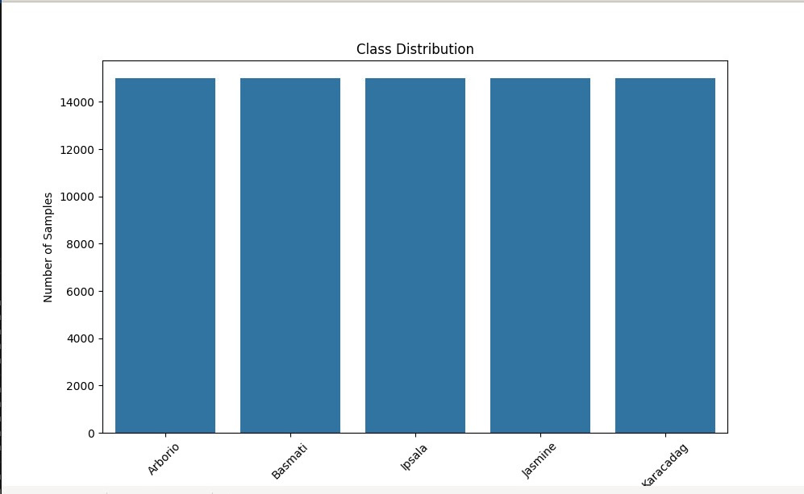
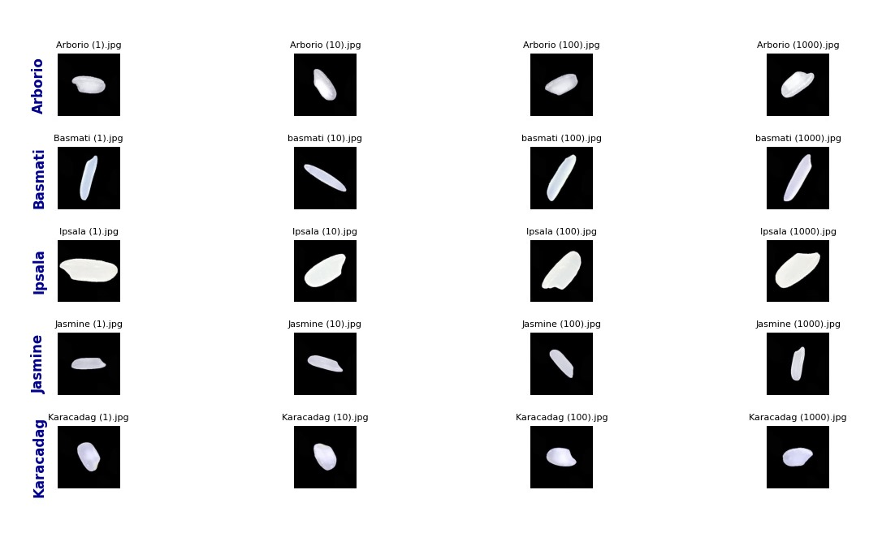
Class Distribution of rice types
First 5 images of the rice types

Slide 5
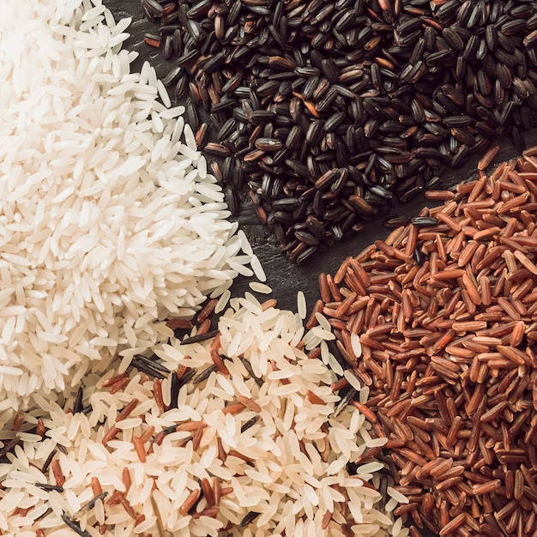
Train – Test Split
Random Split
Divided data into 80% training and 20% testing using Spark's random split function.
Training set = 12,000 x 5classes = 60000 images
Testing set = 3,000 x 5classes = 15000 images
Encoding Labels
Used LabelEncoder to convert textual labels into numerical form for the model.

Slide 6
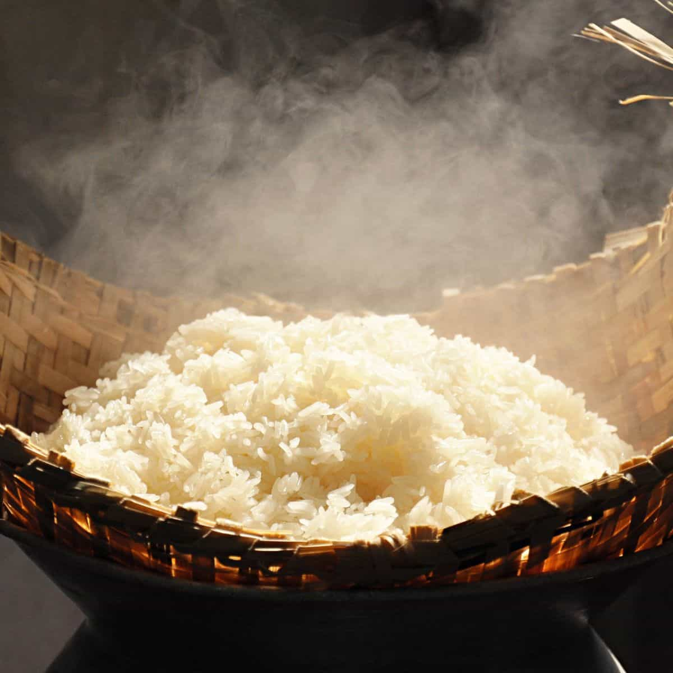
Data Preprocessing:
Technique: Applied transformations (rotation, shift, shear, zoom, horizontal flip) to
augment training images.
Image Size: Resized all images to 150x150 pixels.
Normalization: Scaled pixel values to a range of [0, 1].
Hyperparameters: Batch size set to 32.

Slide 7
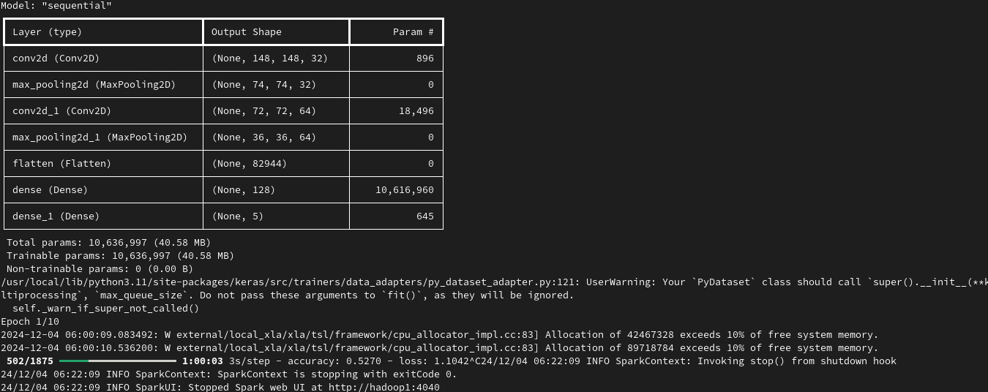
Model Architecture
Convolutional Layers: Extract spatial features from the images.
Pooling Layers: Downsample feature maps to reduce computational load.
Dense Layers: Learn high-level representations for classification.
Output Layer: Provides class probabilities using softmax.

Slide 8
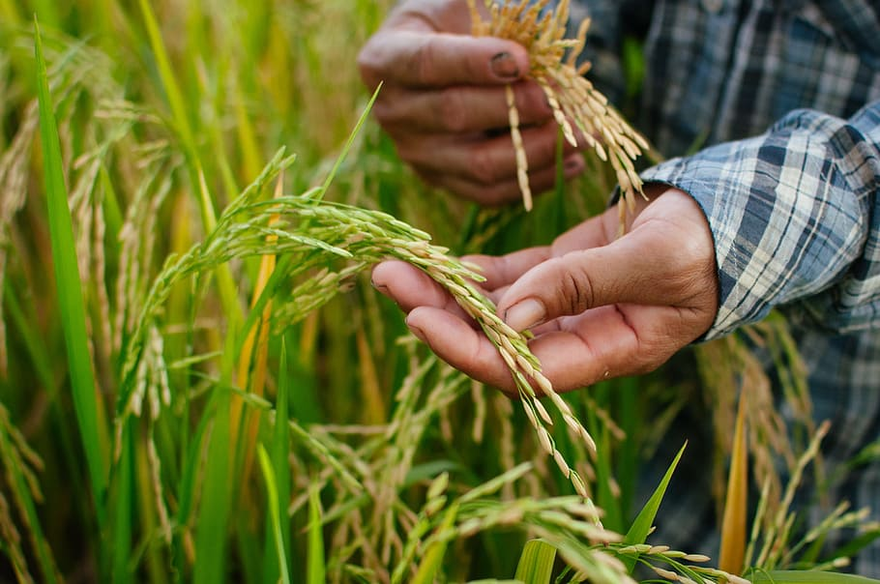
Hyperparameters
Optimizer: Adam optimizer with a learning rate of 0.001.
Loss Function: Categorical cross-entropy for multi-class classification.
Epochs: Trained the model for 10 iterations.
Metrics: Monitored accuracy during training and validation.

Slide 9
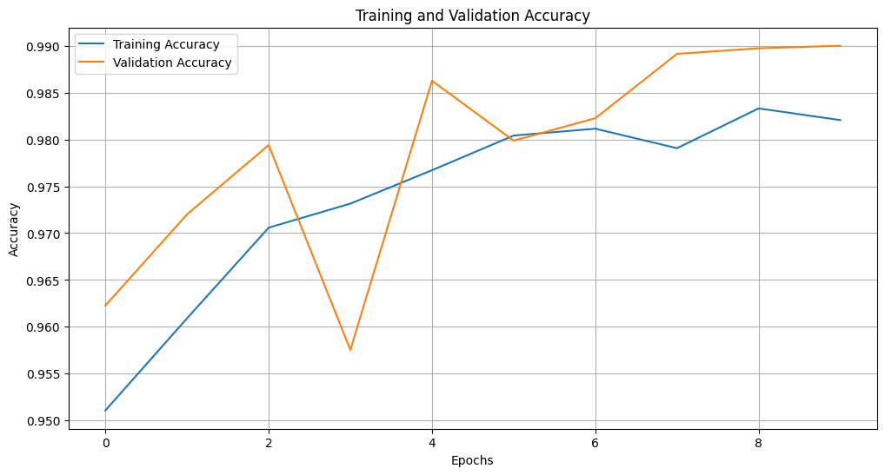
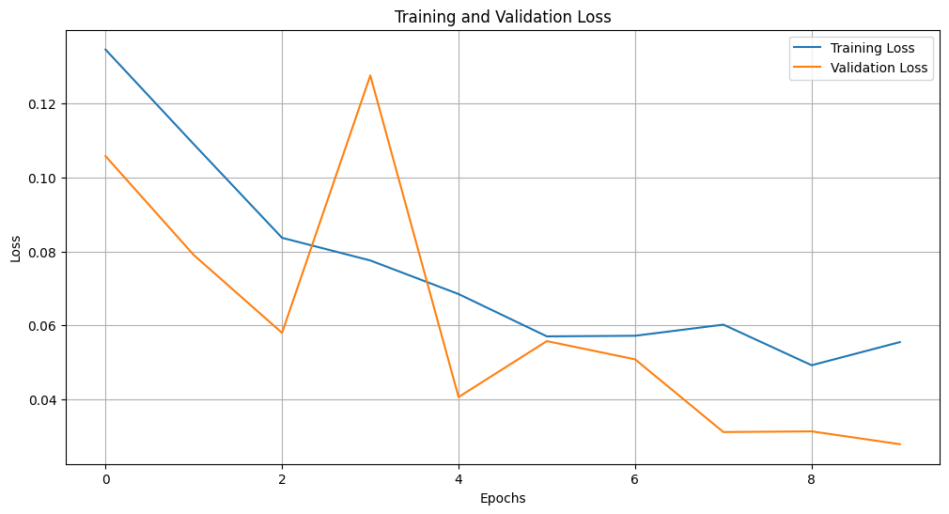
Training Performance
accuracy: 0.9825
loss: 0.0534
val_accuracy: 0.9900
val_loss: 0.0279

Slide 10
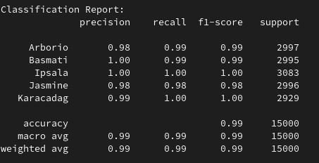
Model Evaluation

Slide 11
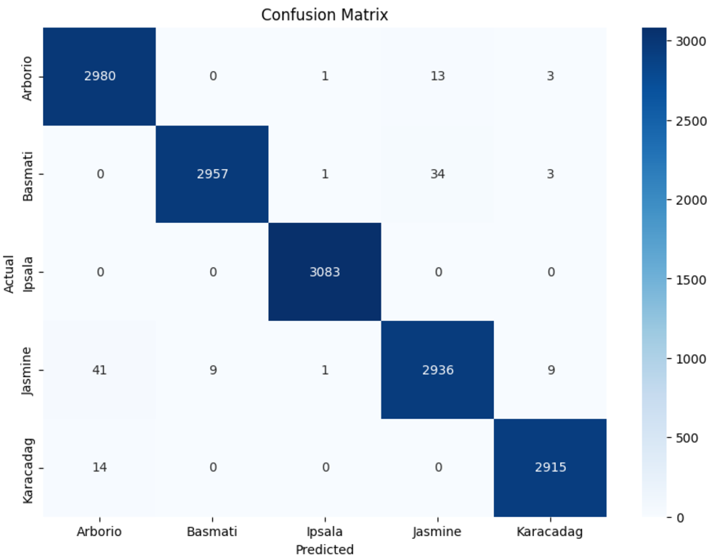
Confusion Matrix
Test Loss: 0.0279 Test Accuracy: 99.10%

Slide 12
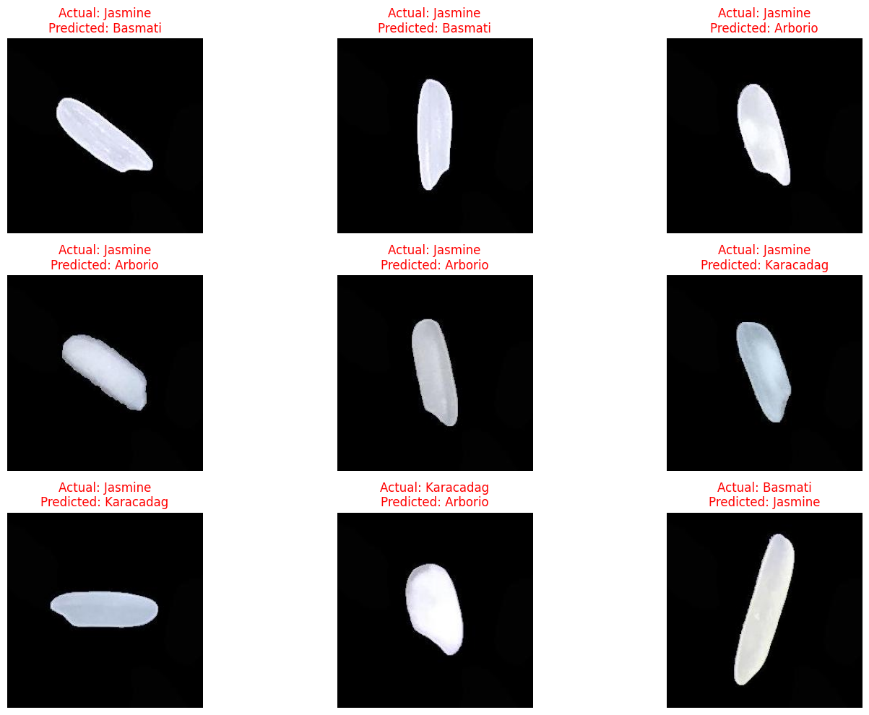
Misclassified Images

Slide 13
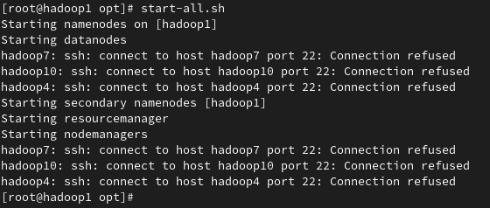
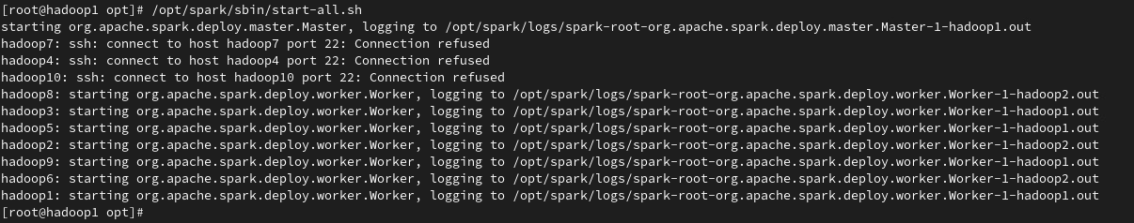
Spark Performance

Slide 14
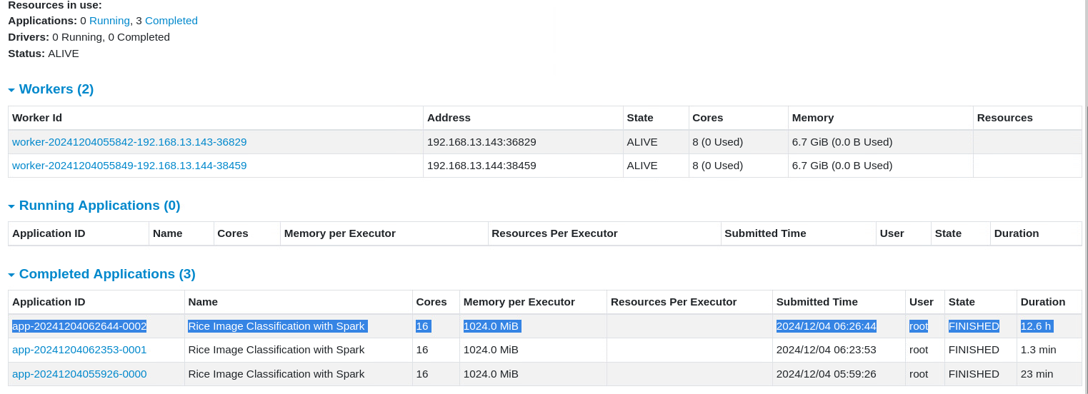
Spark Performance on 2 VM’s

Slide 15
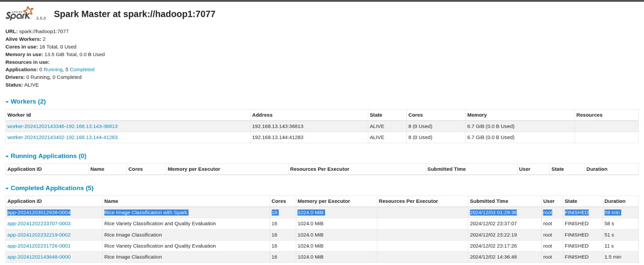
Spark Performance on 7 VM’s

Slide 16

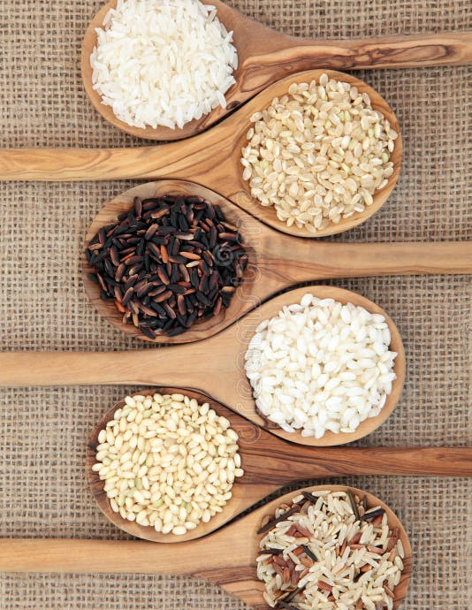
Thank You

